Slide 1
How to plan Network Upgrade
A site survey provides much information to the network designer and creates a proper starting point for the project.
It shows what is already on site, and gives a good indication as to what is needed.
A sales representative may accompany the technician to the site to interview the customer as well.
Some of the more important pieces of information that can be gathered during a site survey include:
Number of users and types of equipment
Projected growth
Current Internet connectivity
Application requirements
Existing network infrastructure and physical layout
New services required
Security and privacy considerations
Reliability and Uptime expectations
Budget constraints

Slide 2
How to plan………….
It is a good idea to obtain a floor plan, if possible.
If a floor plan is not available, the technician can draw a diagram indicating the size and locations of all rooms.
An inventory of existing network hardware and software is also useful to provide a baseline of requirements.

Slide 3
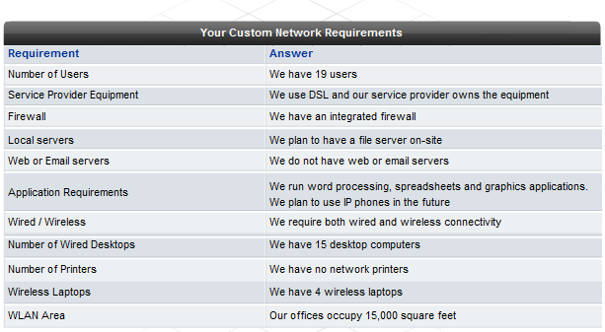

Slide 4
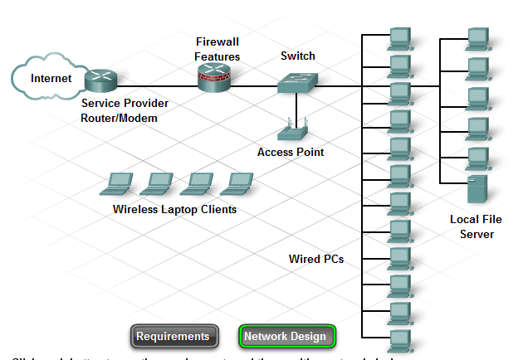

Slide 5
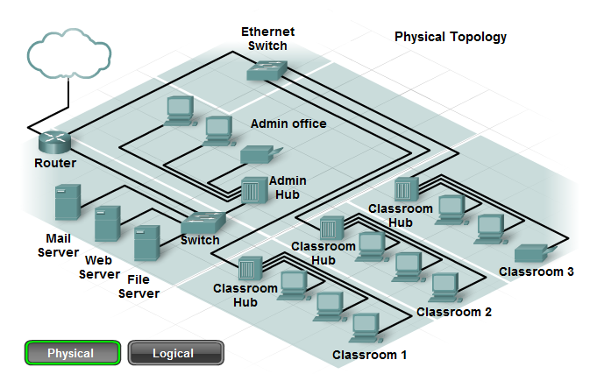

Slide 6
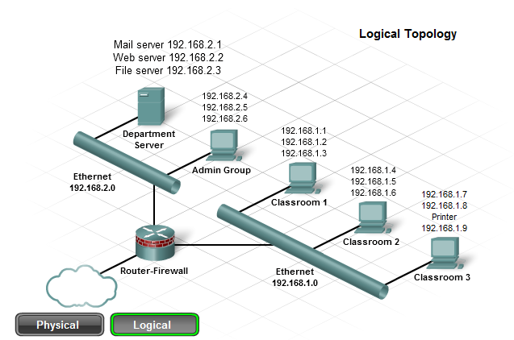

Slide 7
it is necessary to obtain additional information about the hosts and networking devices that are currently installed in the network.
This information should be recorded on a brief inventory sheet. In addition to currently installed equipment, document any planned growth that the company anticipates in the near future.
This information helps the network designer determine what new equipment is required, and the best way to structure the network to support the anticipated growth.
The inventory sheet of all the network installed devices includes:
Device name
Location
Brand and model
Operating system
Logical addressing information
Method of connectivity
Security information

Slide 8
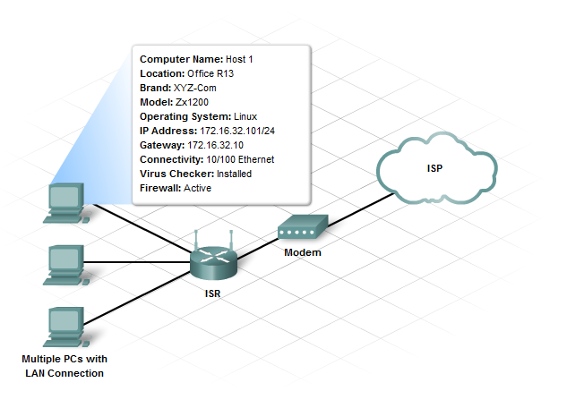

Slide 9
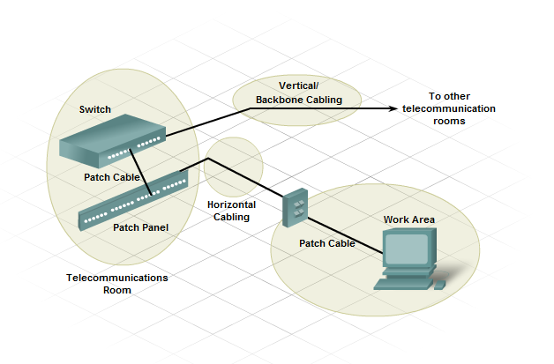
Cabling consideration

Slide 10
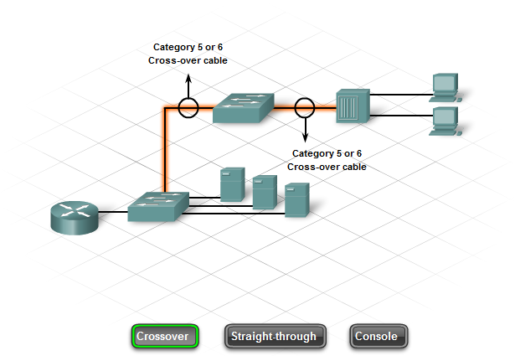

Slide 11
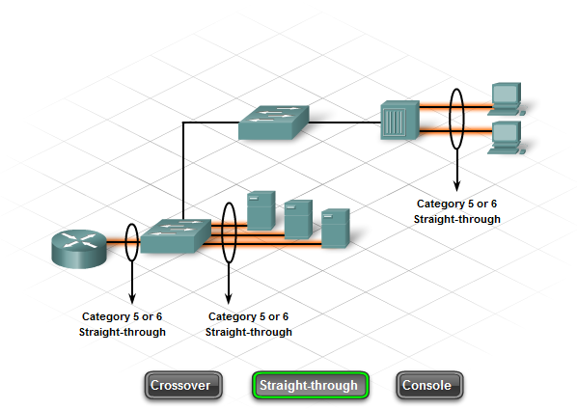

Slide 12
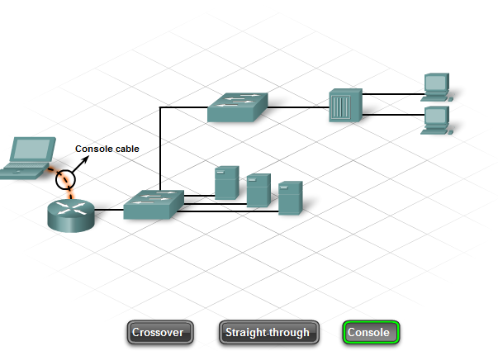

Slide 13
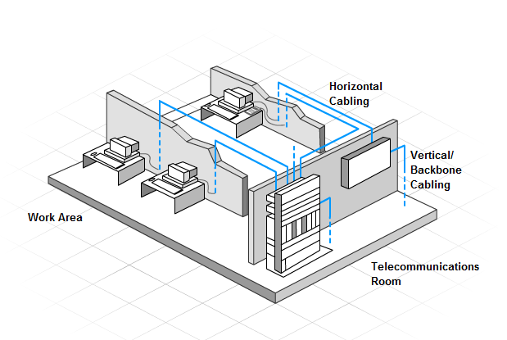

Slide 14
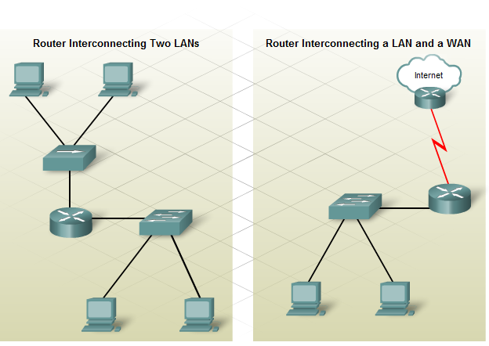

Slide 15
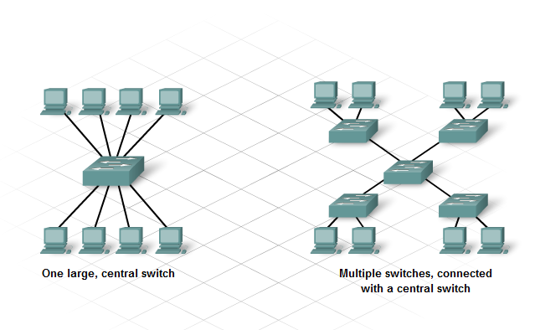

Slide 16
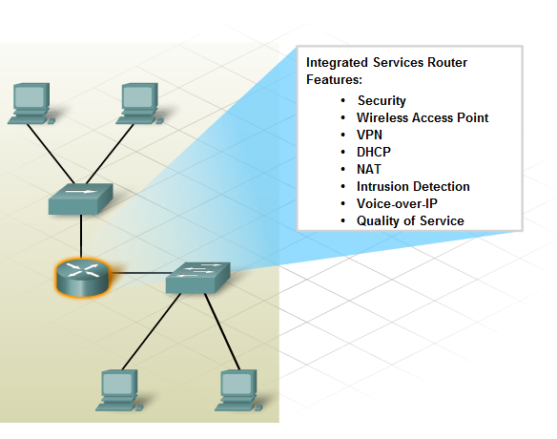

Slide 17
Cisco 1841 ISR
Cisco 2960 Switch
The Cisco 1841 is designed to be a branch office or medium-sized business router.
As an entry-level multi-service router, it offers a number of different connectivity options.
It is modular in design and can deliver multiple security services.

Slide 18
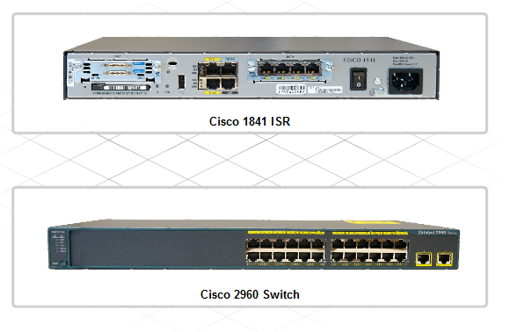

Slide 19
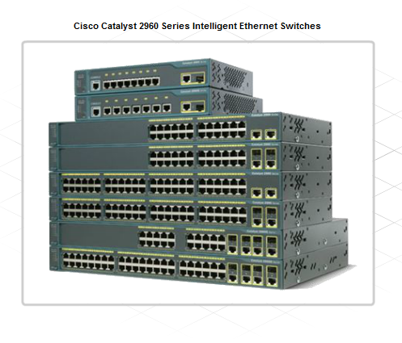

Slide 20
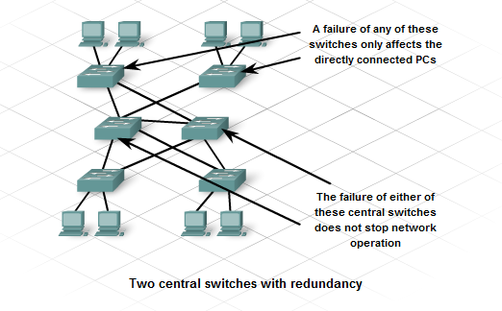

Slide 21
IP Addressing Plan
Planning for the network installation must include planning the logical addressing.
Changing the Layer 3 IP addressing is a major issue when upgrading a network.
If the structure of the network is going to be changed in the upgrade, the IP address scheme and network information may need to be altered.
Consideration must be given to every device that requires an IP address, now and in the future. The hosts and network devices that require an IP address include:
User computers
Administrator computers
Servers
Other end devices such as printers, IP phones, and IP cameras
Router LAN interfaces
Router WAN (serial) interfaces
There are also devices that might need an IP address in order to access and manage them. These include:
Stand-alone switches
Wireless Access Points
For example, if a new router is introduced to the network, new local networks, or subnets, will be created.
These new subnets will need to have the proper IP address and subnet mask calculated.
Sometimes, this means having to assign a totally new addressing scheme on the network.

Slide 22
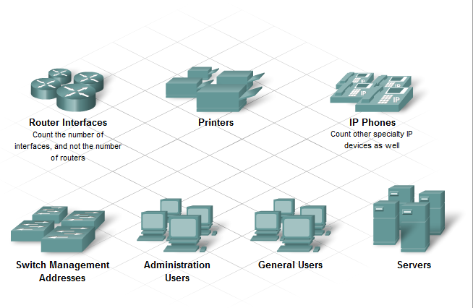

Slide 23
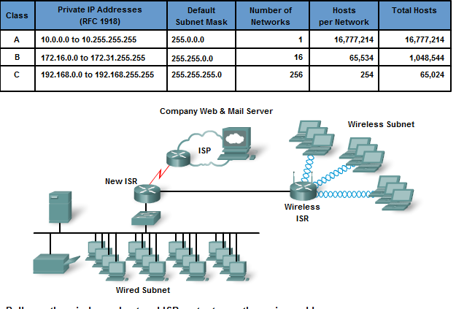

Slide 24
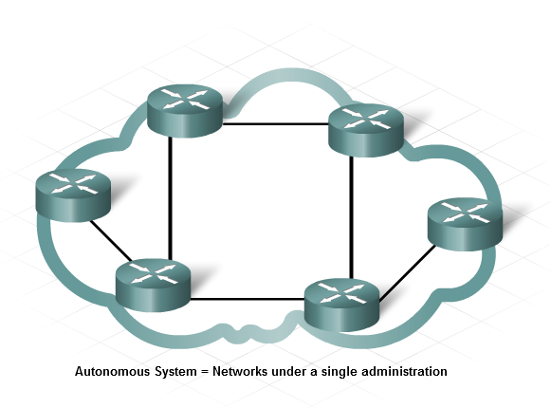

Slide 25
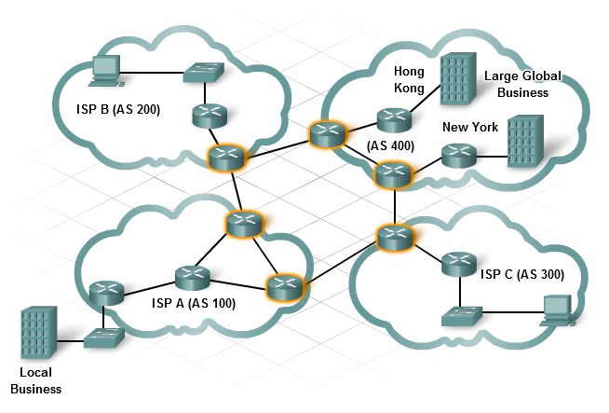

Slide 26
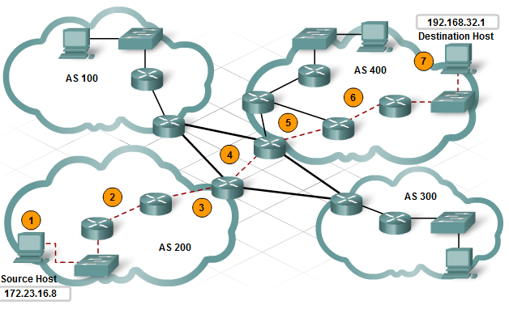

Slide 27
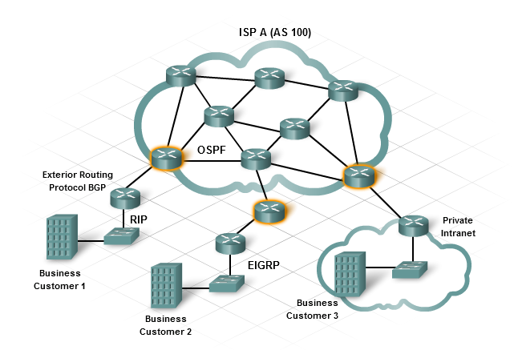

Slide 28
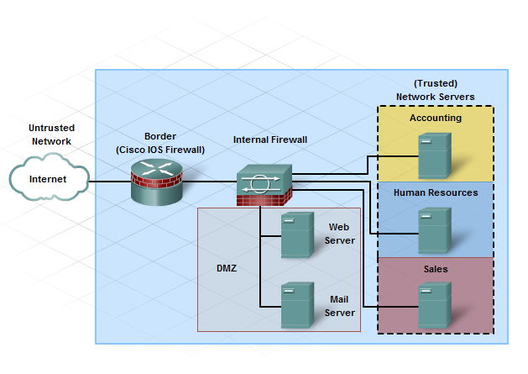

Slide 29
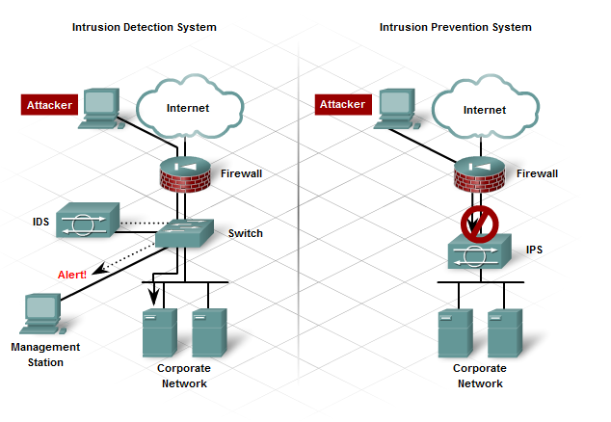

Slide 30
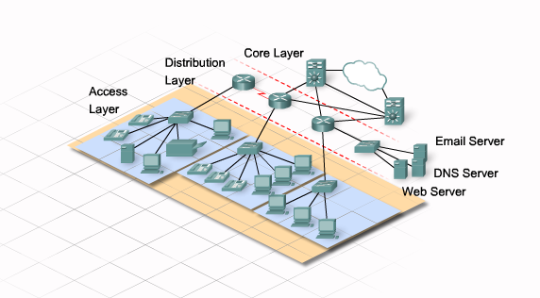

Slide 31
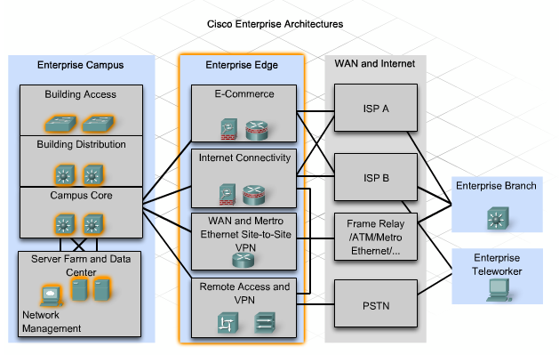

Slide 32
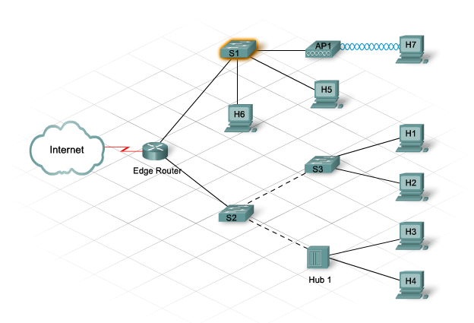

Slide 33
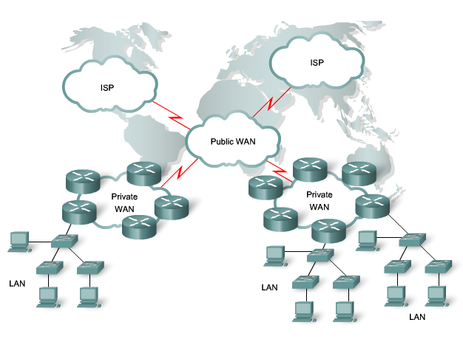

Slide 34
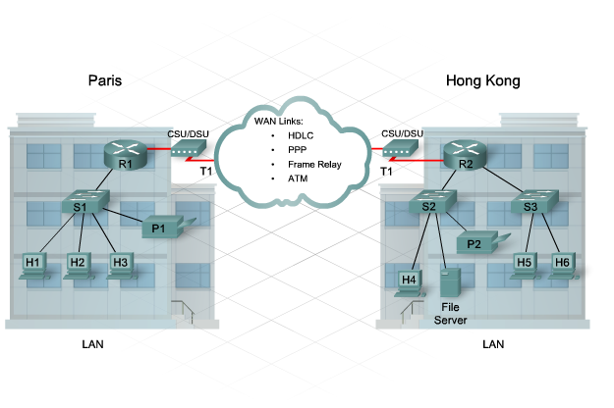

Slide 35
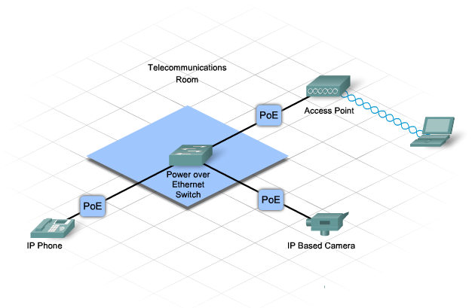

Slide 36
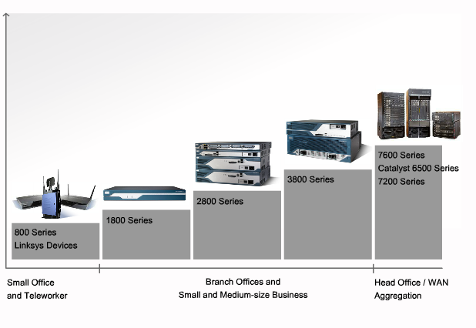

Slide 37
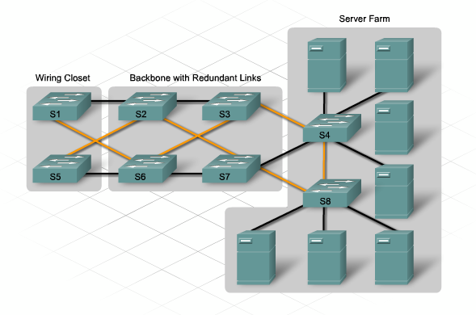

Slide 38
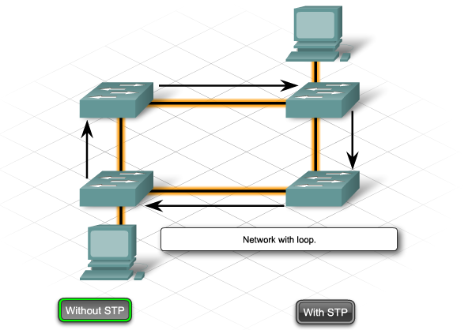

Slide 39
STP
STP defines a tree that spans all the switches in an extended star switched network. Switches are constantly checking the network to ensure that there are no loops and that all ports function as required.
To prevent switching loops, STP:
Forces certain interfaces into a standby or blocked state
Leaves other interfaces in a forwarding state
Reconfigures the network by activating the appropriate standby path, if the forwarding path becomes unavailable

Slide 40
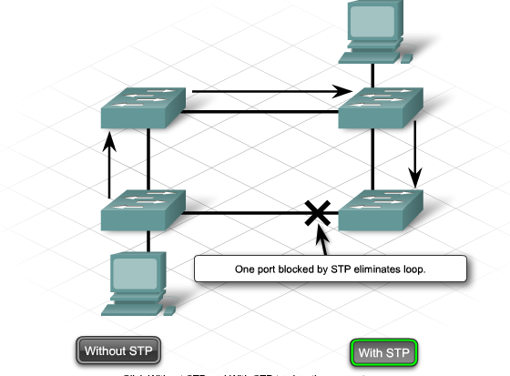

Slide 41
In STP terminology, the term bridge is frequently used to refer to a switch. For example, the Root Bridge is the primary switch or focal point in the STP topology.
The root bridge communicates with the other switches using Bridge Protocol Data Units (BPDUs). BPDUs are frames that multicast every 2 seconds to all other switches. BPDUs contain information such as:
Identity of the source switch
Identity of the source port
Cost of the source port
Value of aging timers
Value of the hello timer

Slide 42
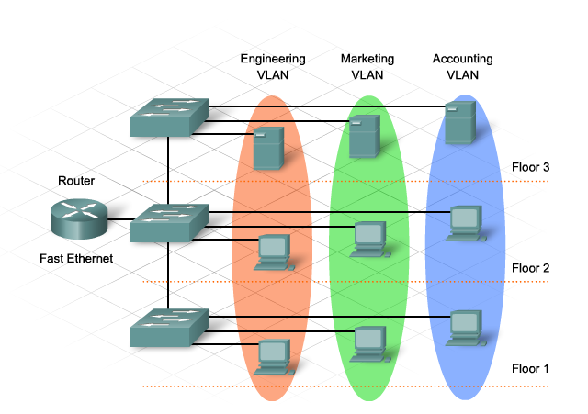

Slide 43
VLAN
Each VLAN functions as a separate LAN. A VLAN spans one or more switches, which allows host devices to behave as if they were on the same network segment.
A VLAN has two major functions:
A VLAN contains broadcasts.
A VLAN groups devices.
Devices located on one VLAN are not visible to devices located on another VLAN.

Slide 44
Traffic requires a Layer 3 device to move between VLANs.
In a switched network, a device can be assigned to a VLAN based on its location, MAC address, IP address, or the applications that the device most frequently uses. Administrators assign membership in a VLAN either statically or dynamically.
Static VLAN membership requires an administrator to manually assign each switch port to a specific VLAN. As an example, port fa0/3 may be assigned to VLAN 20. Any device that plugs into port fa0/3 automatically becomes a member of VLAN 20.

Slide 45
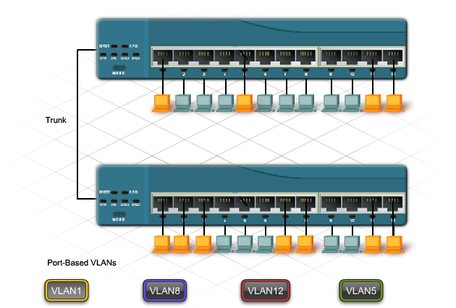

Slide 46
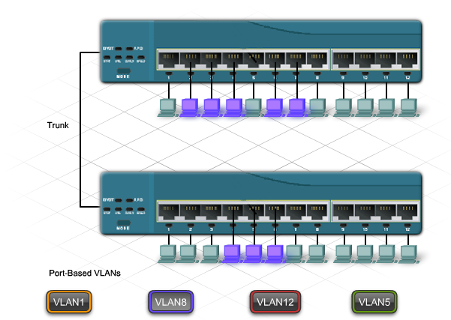

Slide 47
A VLAN has three major functions:
Limits the size of broadcast domains
Improves network performance
Provides a level of security
To take full advantage of the benefits of VLANs, they are extended across multiple switches.
Switch ports can be configured for two different roles. A port is classified as either an access port or a trunk port.
Access Port
An access port belongs to only one VLAN. Typically, single devices such as PCs or servers connect to this type of port. If a hub connects multiple PCs to the single access port, each device connected to the hub is a member of the same VLAN.

Slide 48
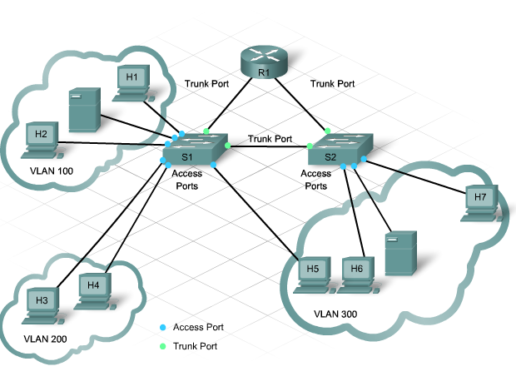

Slide 49
Trunk Port
A trunk port is a point-to-point link between the switch and another networking device.
Trunks carry the traffic of multiple VLANs over a single link and allow VLANs to reach across an entire network.
Trunk ports are necessary to carry the traffic from multiple VLANs between devices when connecting either two switches together, a switch to a router, or a host NIC that supports 802.1Q trunking.

Slide 50
